Slide 1
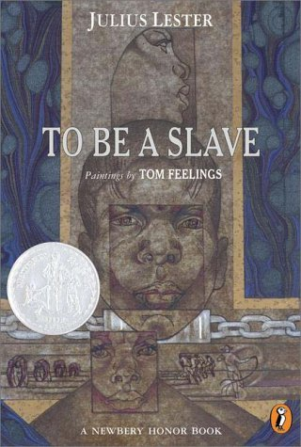
To Be a Slave by Julius Lester
“It is rare to find a book that enables children to identify as compellingly with the slaves as this one does.” - Publishers Weekly
“From history-and for our time-there’s nothing better than To Be a Slave.”
- New York Times Book Review

Slide 2
How the Story is Told
Uses 19th C. slave narratives & work of Federal Writers’ Project to allow slaves to tell experience in their own words
Chapters begin w/ brief narrative, then use words of slaves to tell story

Slide 3
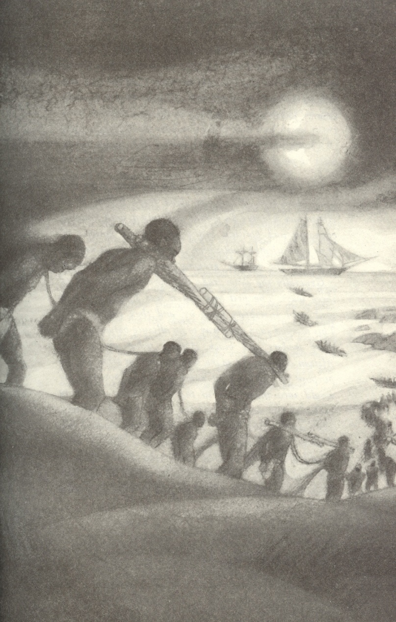
Prologue - Taken from Africa
Traces the birth of the African slave trade & its introduction in America
“I was knocked down by a heavy blow of a club, and when I recovered from the stupor that followed, I found myself tied fast with the long rope…”
“More than a third of us died on the passage and when we arrived at Charleston, I was not able to stand. It was more than a week after I left the ship before I could straighten my limbs.”

Slide 4
Chapter 1 - To Be a Slave
Brings to life what it felt like to be owned by another human being – and the varying nature of slave experiences
“Anytime ol’ massa got a slave that been cuttin’ up or something, he tell Gave to give that slave a lashin’. Sometime he comedown to the barn to watch it, but most time he just set on the porch and listen to the blows.”
“The master would make us slaves steal from each of the slave owners. Our master would make us surround a herd of his neighbor’s cattle and round them up at night.”

Slide 5
Chapter 2 - The Auction Block
Humanizes the slave experience of being bought and sold with no regard to family
“When her fourth baby was born and was about two months old…she said ‘I just decided I’m not going to let ol’ master sell this baby.’ She give it something out of a bottle and pretty soon it was dead.”
“My master took the paper I brought and after looking at it a minute he turned to mistress and said, “That old Yankee [Lincoln] has got elected and I am going to sell every slave I got because he is going to free them.”

Slide 6
Chapter 3 – The Plantation
Details the life on the plantation from the slaves point of view including:
Slave quarters
Slave clothing (or lack there of)
Slave labor
Working dawn till dusk and sometimes through to night to pick 200lbs of cotton or more
Chores to do after cotton picking
Little food provided for slave meals

Slide 7
Chapter 4 – Resistance to Slavery
Used many tools to retain humanity and have different attitudes about themselves from the slave owners
These include…
Religion & Music
Feigning illness and injury
Sabotaging work
Sneaking away to meet as a group and dance

Slide 8
Chapter 5 – More Resistance to Slavery
Others took more active resistance
Slave insurrections (all in United States failed)
Escape to freedom
Suicide, especially if caught while trying to escape

Slide 9
Chapter 6 - Emancipation
With the outbreak of the Civil War, slaves served for both the Union and Confederate Armies
In the Union Armies, former slaves were given a wage for their work
“Don’t be scared of the Yankees. And even if we should get killed, it won’t be much worse than staying here.”
In the Confederate Armies, slaves served as body servants or stayed on the Plantation to feed the war effort.

Slide 10
Chapter 6 – Emancipation
Although the Emancipation Proclamation had little actual effect, once slaves heard rumors they were freed, they did not hesitate.
“I’m free! Yes, I’m free! Ain’t got to work for you no more. You can’t put me in your pocket now!”

Slide 11
Chapter 7 - After Emancipation
Although slaves were free in name, many were forced to be sharecroppers on their former owner’s land, thus little had changed.
Resistance groups such as the KKK formed to keep blacks from obtaining true freedom.
“If they (former slaves) got so they made good money and had a good farm, the Klu Klux would come and murder them… They’d go to jails and take the colored men out and knock their brains out and break their necks and throw ‘em in the river.”

Slide 12
Epilogue
The Federal Writers’ Project, formed during the Great Depression, conducted interviews of ex-slaves to break certain stereotypes.
“Lincoln got the praise for freeing us, but did he do it? He give us freedom without giving us any chance to live to ourselves and we still had to depend on the southern white man for work, food and clothing, and he held us out of necessity and want in a state of servitude but little better than slavery…The Yankees helped free us, so they say, but they let us be put back in slavery again.”

Slide 13
How to use in the Classroom
Jigsaw Technique
Each student becomes “expert” on their chapter(s)
Students responsible for summarizing chapter and pulling most relevant quotes from chapter to share with rest of group
Group writes paragraph/essay conveying meaning of book, using quotes from book

Slide 14
How to Use in the Classroom
Have students draw a picture of what the plantation would look like from the slave point of view
Write an essay and/or have a discussion on the differences with the paternalistic view of slave holders with the reality of slave life
Compare and contrast white abolitionists to slave resistance

Slide 15
How to Use in the Classroom
Make a timeline that traces the evolution of American Slavery from the early 1600s to the mid 1900s
Create a mural depicting the six stages of a slave’s life

